Slide 1

Redefining Web3 Games
FANTASIATECH

Slide 2
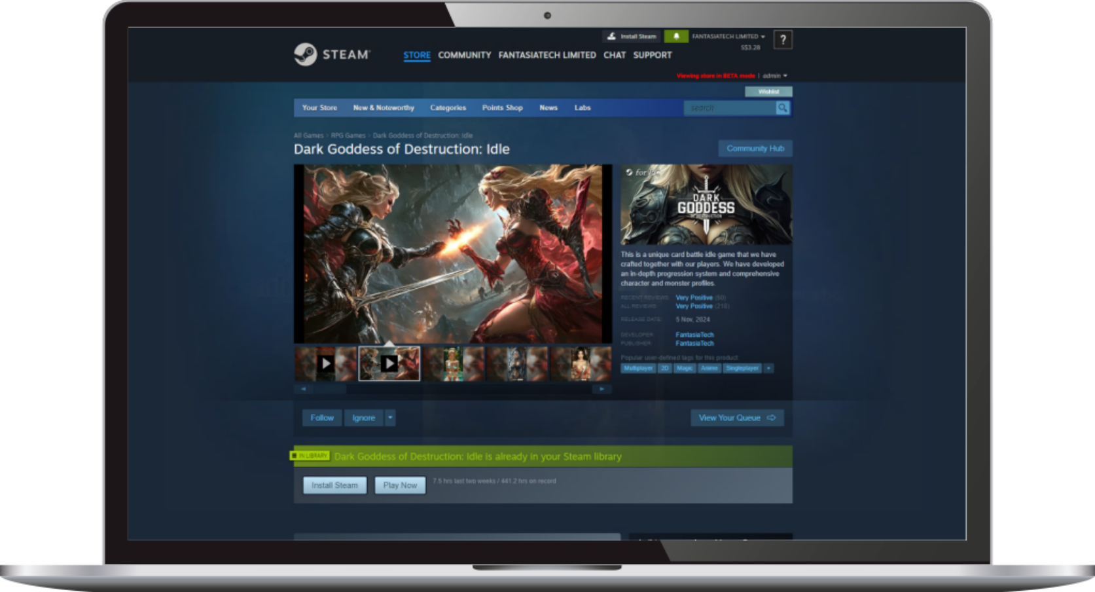
Our Proven Success 我们已验证的成功
DGOD On STEAM 暗黑女神录
The Phase 0 of the project, which is the web2 version, was released on the Steam platform. 项目的P0阶段，是创造一个真正具有可玩性的WEB2游戏，游戏已经在STEAM平台发布上线
AFK Battle & Finger-tip MOBA.
融合MOBA体验的放置卡牌游戏
Tradeable Goddess Skins
可交易的装备和AI卡牌
Infinite World
基于AI技术生成的无限游戏场景
Infinite Model
无限成长的游戏数值体系

Slide 3
Data Sharing 数据分享
STEAM Test Data 测试数据
We adopted a development approach that involves continuous testing, using feedback from traditional gamers to refine and polish the game during this process. At the same time, in order to avoid excessive exposure, we intentionally limited the game’s dissemination and kept the number of testers to a few thousand.（Data as of March 19, 2025）
Test Users | Total Recharge (HKD) | Number of Paying Users | Payment Rate | ARPU (HKD)
6,307 | $229,147 | 653 | 10% | $351
Daily Average Online Duration | Next-day Retention Rate | 7-day Retention Rate | 30-day Retention Rate | Steam Positive Review Rate
38Min | 52% | 30% | 19% | Very Positive
Cumulative Transaction Volume (HKD) | Cumulative Number of Transactions | Average Number of Transactions per Person
$259,422 | 63,256 | 10
In-game transactions are completed through Steam's Market function.

Slide 4
NOW, IT WILL BE A WEB3 GAME
游戏链化——不止于游戏，更是资产革命

Slide 5
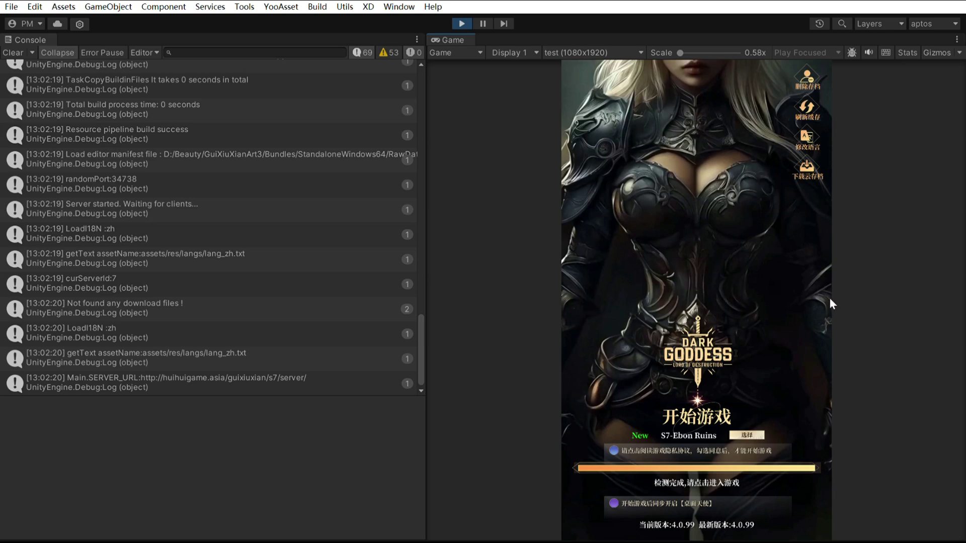
The WEB3 Evolution 游戏链化
Free To Play 免费游戏
Most Web3 games lose 99% of Web2 users as soon as they start playing 大部分WEB3游戏，开始游戏即需要开通钱包，流失99%的WEB2用户
No upfront payment for players; conversion rate up 20x 我们不需要玩家前置付费，WEB2-WEB3的转化率大幅提升20倍

Slide 6
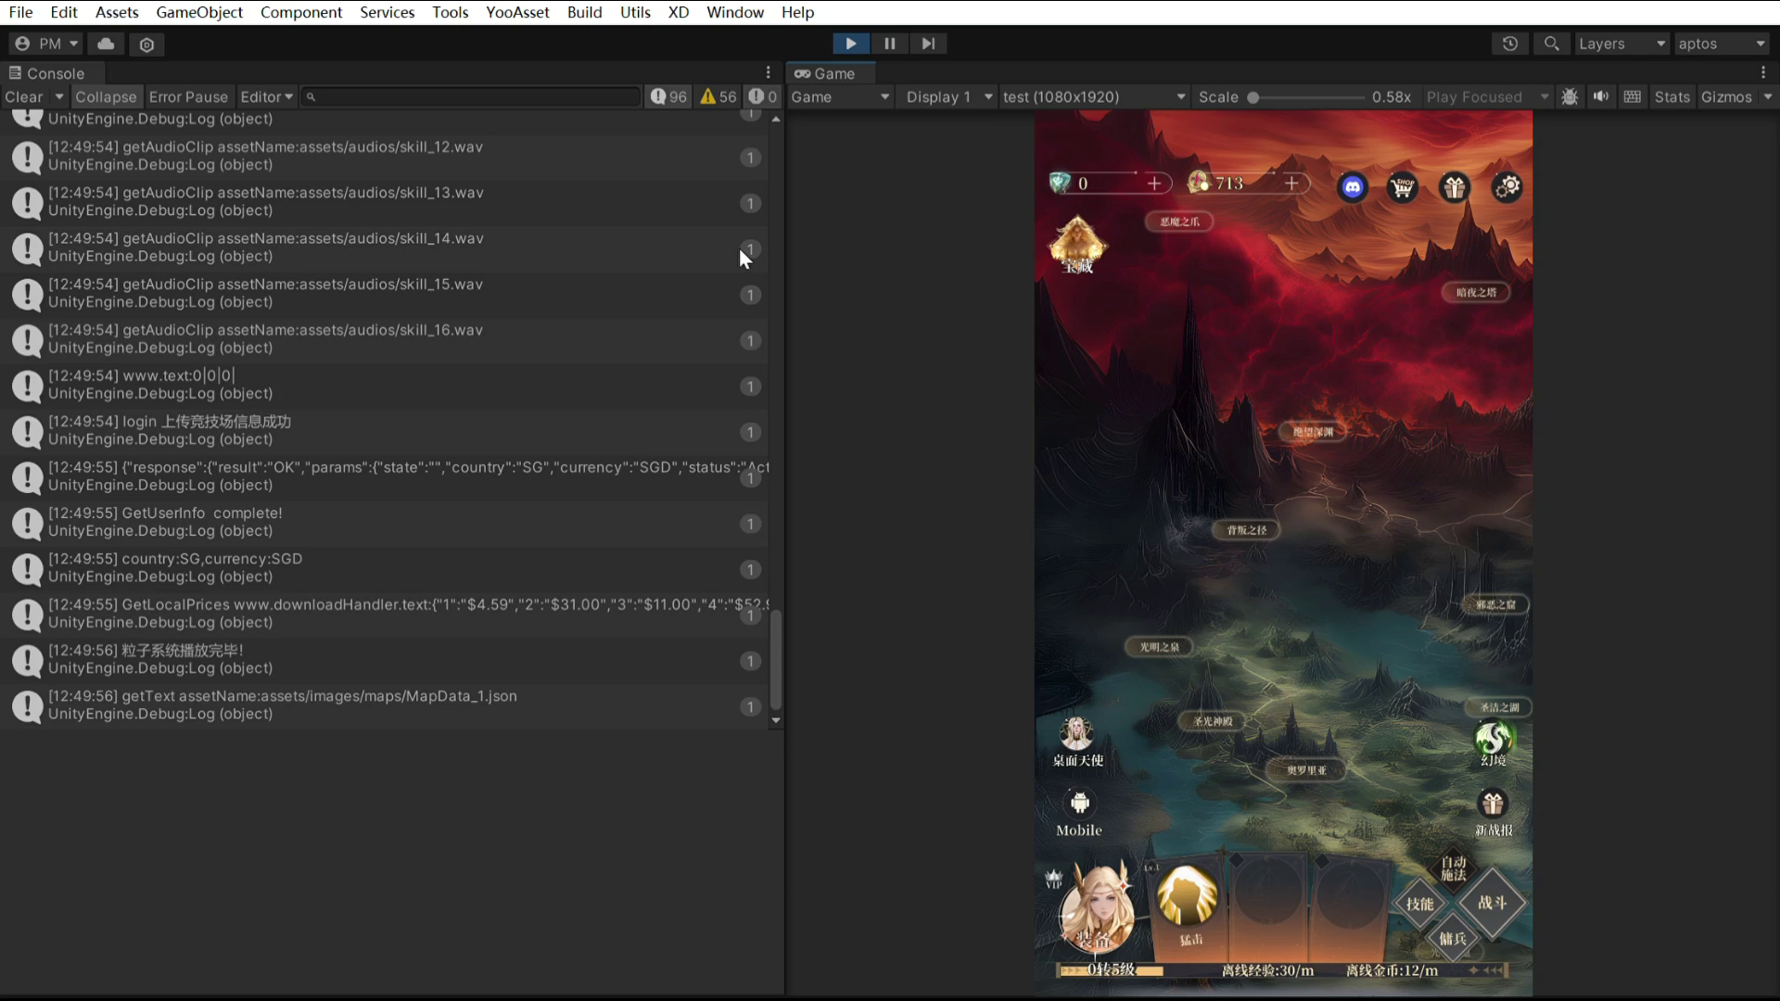
The WEB3 Evolution 游戏链化
Asset Tokenization 资产上链
In-game equipment and skins both support tokenization 游戏内装备和皮肤均支持上链
The current video demonstrates the process of tokenizing skins 当前视频演示的是皮肤上链的过程
红色叹号为重要日志特殊标识，而非报错。

Slide 7
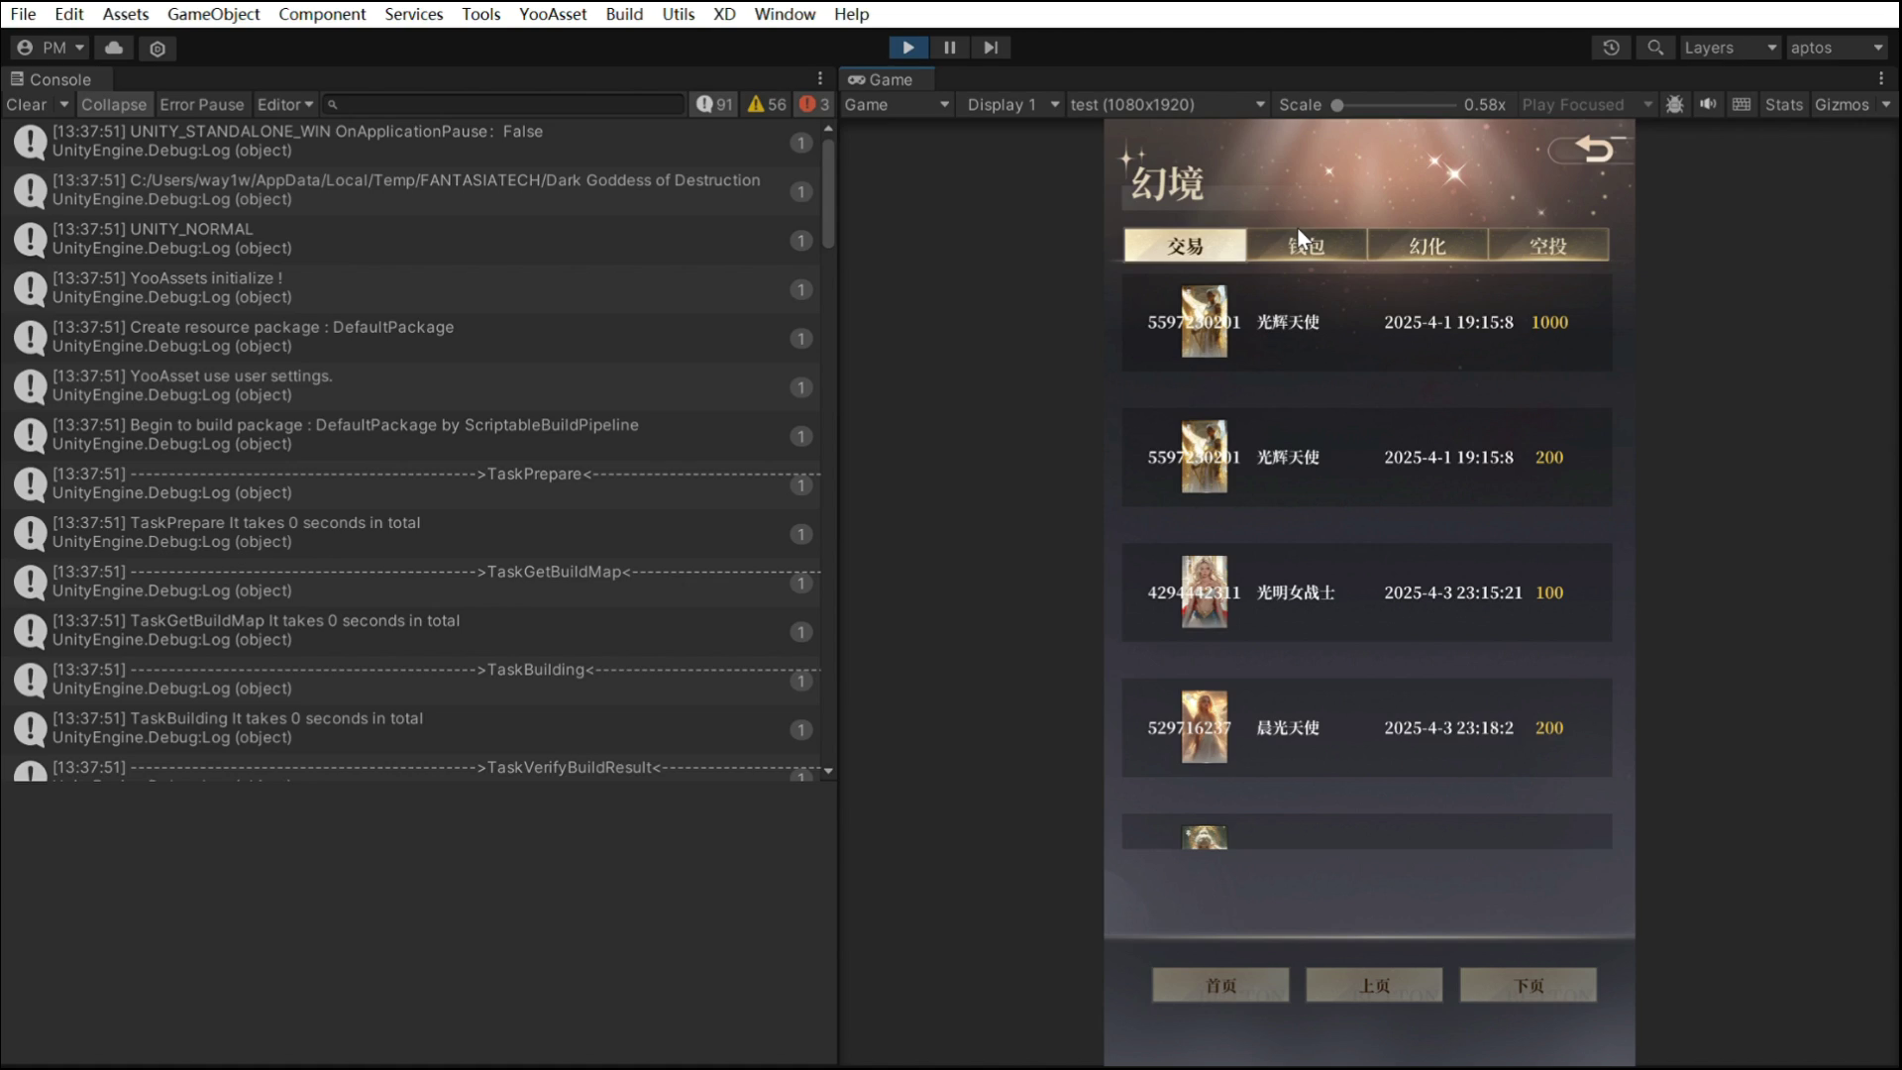
The WEB3 Evolution 游戏链化
In-game APTOS wallet 内置钱包
In-game APTOS wallet 游戏内置APTOS钱包
Store APT. and NFT assets, and support deposits and transfers 存储代币和NFT资产，并支持充值及转账

Slide 8
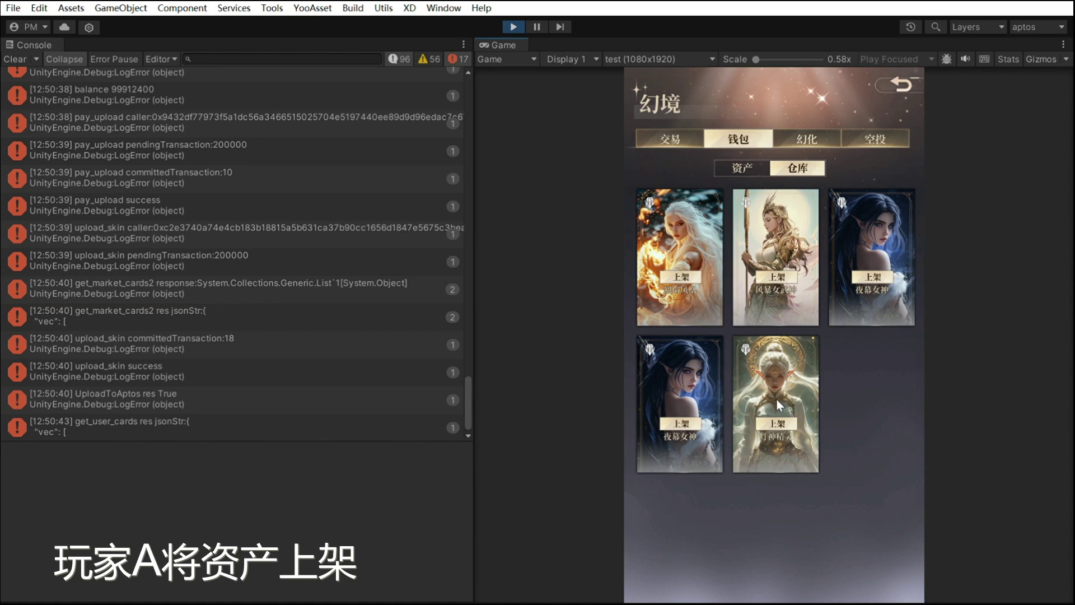
The WEB3 Evolution 游戏链化
Decentralized Marketplace 内置交易市场
Built-in cross-game NFT exchange (supporting the APTOS chain) 内置跨游戏NFT交易所（支持APTOS链）
Royalty Automation: 5% creator cut enforced by smart contracts 智能合约自动分润（开发者抽成5%→链上执行）

Slide 9
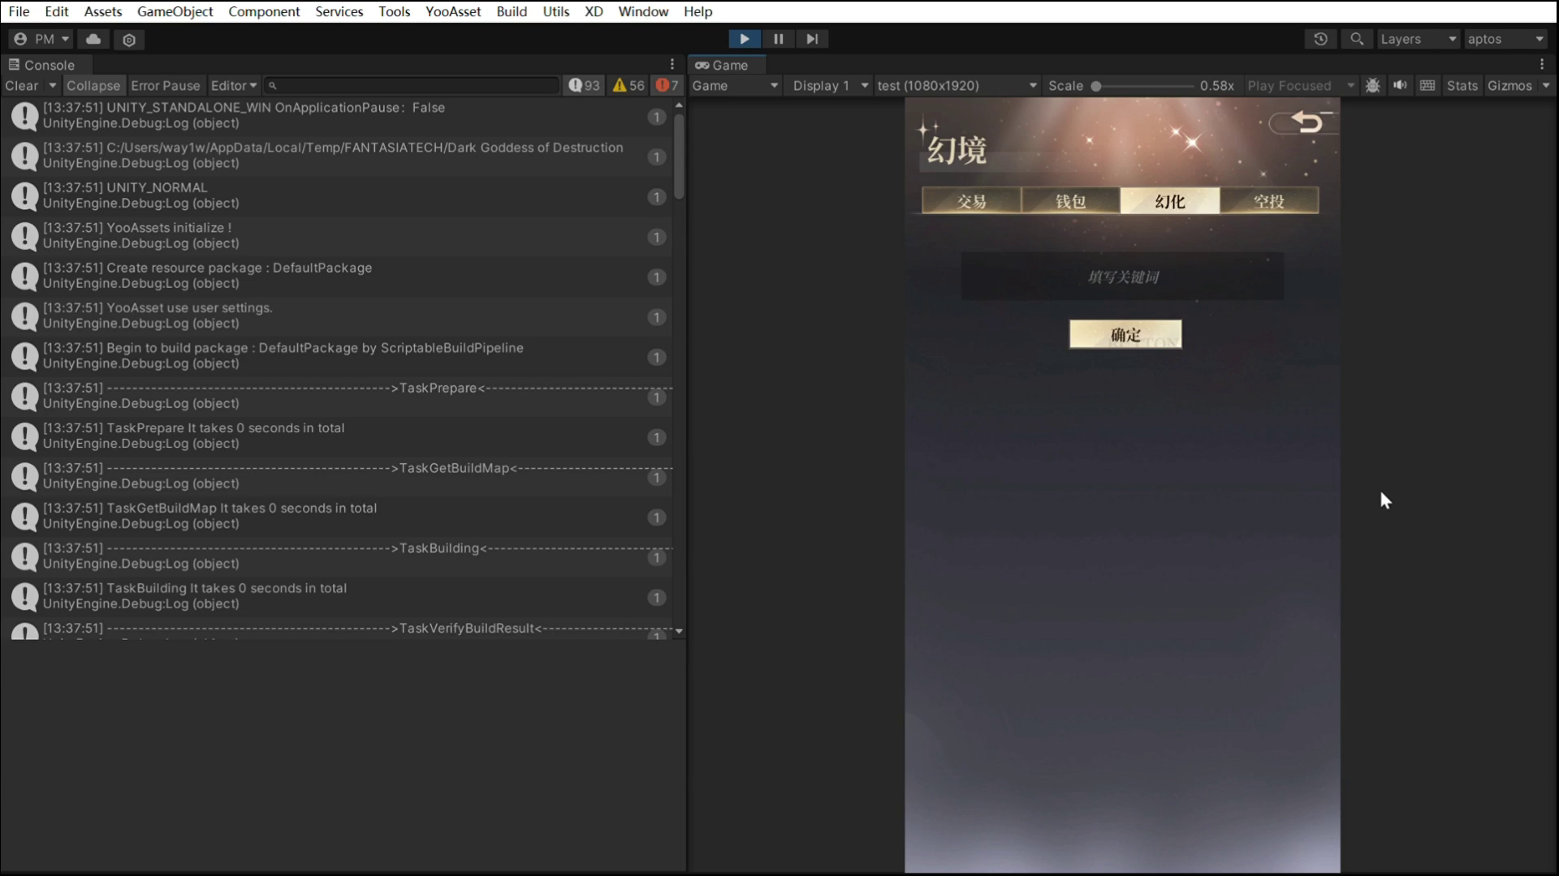
The WEB3 Evolution 游戏链化
AI-Powered Asset Generation AI资产生成
Based on AI technology, it supports users in directly creating on-chain game assets 基于AI技术，支持用户直接创造链游戏资产
Players input text → Generate equipment → Click to tokenize 玩家输入文案→生成装备→点击上链

Slide 10
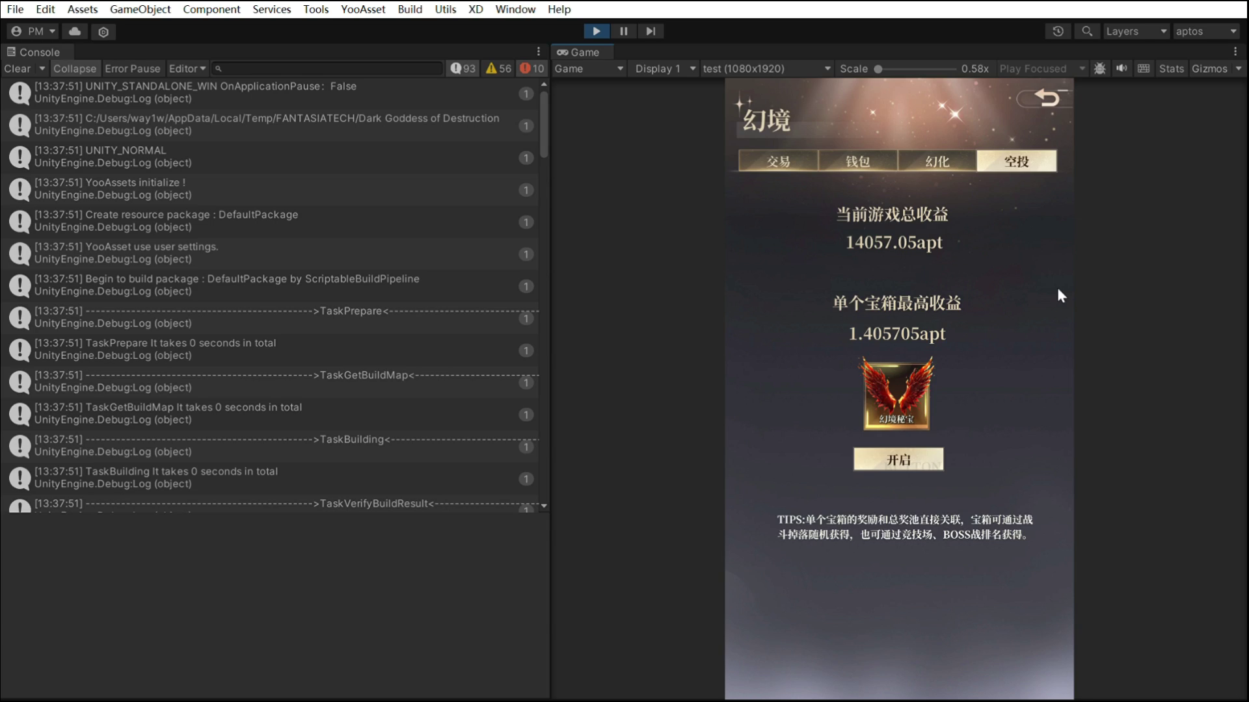
The WEB3 Evolution 游戏链化
Decentralized profit sharing 收益分享
Publicly share X% of the on-chain revenue with players 将X%的链上收益，公开分享给玩家
Obtain on-chain mystery boxes through game systems such as combat, social sharing, and arenas 战斗、社交分享、竞技场等游戏系统获取链上盲盒

Slide 11
The SDK Revolution - Gaming's Next Development Standard
从游戏到生态 — FANTASIA SDK的愿景

Slide 12
The SDK Revolution 游戏链化
FANTASIA SDK 游戏生态价值
适配层
03
Unity/Unreal/Godot plugins 各种游戏引擎无缝对接
链抽象层
02
APTOS core + multi-chain extension APTOS为主链，一键切换多链生态
01
应用层
No-code token rule configurator 拖拽式配置资产规则

Slide 13
The SDK Revolution 游戏链化
FANTASIA SDK 游戏生态价值
01
02
Traditional 传统链改方案
FANTASIA SDK
6-12 month development cycle 6-12个月开发周期
Needs dedicated crypto dev team 需区块链团队支持
35%+ user drop-off rate 玩家流失率35%+
7-day integration 7天完成接入
Game designers can self-configure 游戏策划自主配置
22% increase in player retention 留存提升22%

Slide 14
For WEB2 DEVELOPER WEB2开发者获得：
New Revenue: NFT mint fees, trading royalties, cross-promotion pools
新增代币化收益通道
Player lifetime value increased by 3 times.
玩家生命周期价值提升3倍
For WEB3 WEB3生态获得：
Tens of millions of real players flood in
千万级真实玩家涌入
On-chain transaction volume grows exponentially
链上交易量指数级增长

Slide 15
We're building the Steam Workshop of WEB3 - where every modder can become a micro-economy
让天下没有难做的链游

